Slide 1
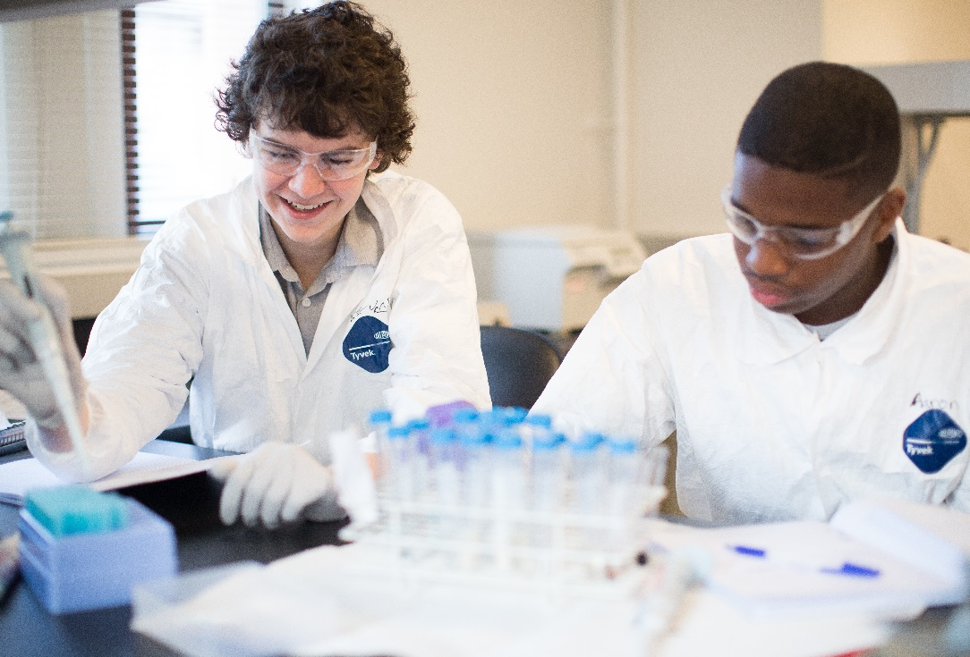
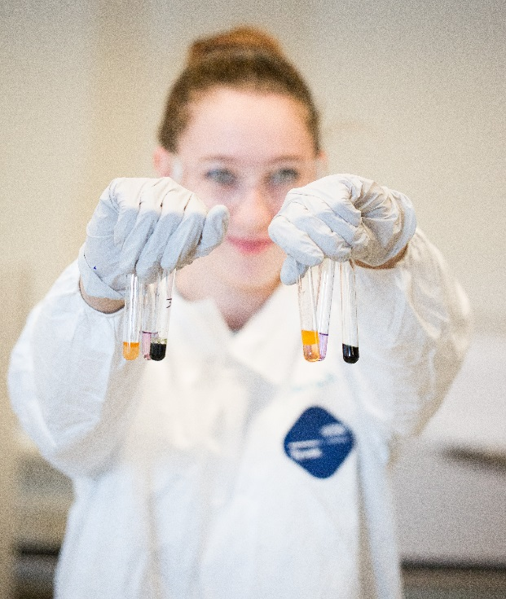
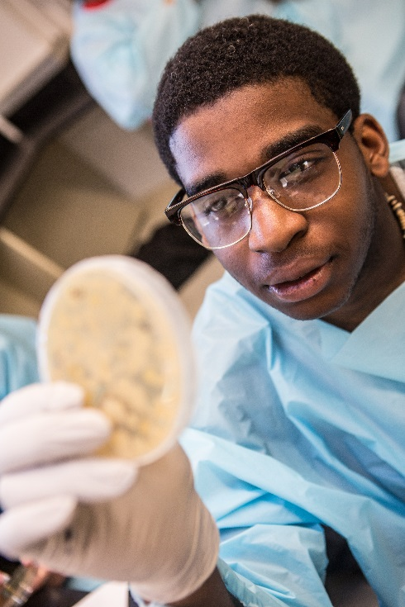



YALE PATHWAYS TO SCIENCE
A Unified Approach to University Engagement in STEM
Claudia Merson, Director of Public School Partnerships
Maria Parente, Ph.D., Coordinator for Community Programs in Science

Slide 2
Yale STEM Outreach Programs
FLAGSHIP PROGRAMS
  Peabody Evolutions After-School Program
  Pathways Summer Scholars Program
  US Grant Summer Program
PLACE-BASED RESOURCES AND PROGRAMS
  Center for Collaborative Arts & Media
  Cushing Center
  Leitner Family Observatory and Planetarium
  Marsh Botanical Gardens
  West Campus
  Yale Center for Engineering Innovation & Design
  Yale Farm Visits & Tours
  Yale Peabody Museum
ON-CAMPUS PROGRAMS & SERIES
  Academic Yale College Courses
  Anatomy Teaching Program
  Design Thinking Workshops
  Engineering Days
  Girls’ Science Investigations
  Green Café
  Emergency Medical Simulation Lab
  Health Professionals Recruitment Exposure Program
  Math Mornings on Sundays
  NanoDays Lectures & Demonstrations (CRISP)
  Peabody Summer Programs
  Play Cafes
  SheCode
  Science on Saturdays
  Shafer Summer Scholarships
  Science in the News
  Science Café & Open Labs
  Yale Splash
  Yale Sprout
ON-CAMPUS INDIVIDUAL OUTREACH EVENTS
  Brain Education Day
  Bone Day
  Chemistry Open House
  Codeboola
  CT Students Exploring Engineering Days
  Engineering Days
ON-CAMPUS INDIVIDUAL OUTREACH EVENTS (cont’d)
  Energy Sciences Institute Day
  Exploring the Intersection of Physics, Engineering, & Biology Day
  Developmental Biology Day
  Discover Chemistry
  Environmental Cafe
  FES Conference for High School Students
  Flipped Science Fairs
  Genomics & Proteomics Day
  Green Careers, Women Leaders
  Green Chemistry Day
  Julia Robinson Math Festival
  Ophthalmology Day
  Physics Olympics
  Public Health Day
  NEWT Café
  Science Olympiad
  Synapse Resonance
  Yale Environmental Watershed Day
INTERNSHIPS/MENTORSHIPS
  Center for Research on Interface Structures & Phenomena
  Discovery to Cure
  STEM Mentors
  Evolutions Internships
  New Haven Hiring Initiative
  New Haven Science Fair Program
  Peabody SciCORPS
  Summer Medical & Dental Education Program
  Summer Science Research Institute
  Yale Cancer Center Internships (CROY)
  Yale Center for Analytical Sciences Biostats Program
SCHOOL-BASED PROGRAMS
  Code Haven
  Community Health Educators
  DEMOs & the STARLab
  First Robotics Competition
  Have Bones, Will Travel
  Math Counts
  Science & Math Achiever Teams (SMArt)
  Urban Resource Initiative
06052018

Slide 3
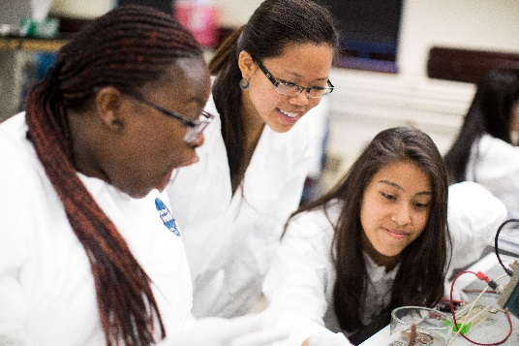
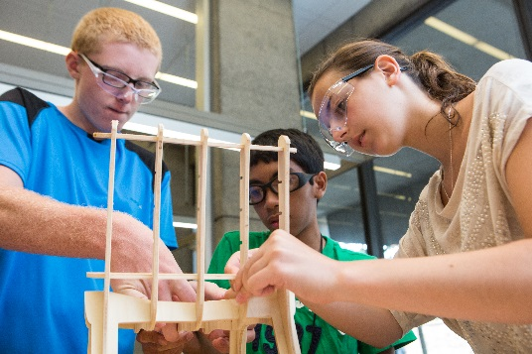
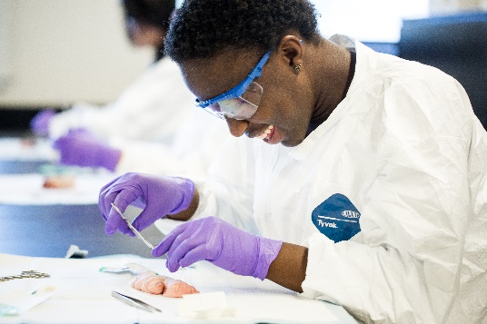
What Is Pathways to Science?
Yale University’s coordinated,
data-driven STEM outreach infrastructure.
Housed in central administration & guided by a steering committee of Yale senior scientists.
Manages contacts & relationships with participating school districts.
Assists Yale science faculty, graduate students and undergraduates in designing & implementing STEM programming.
Identifies and supports a target group of local pre-college students in achieving success in STEM.
Maintains a longitudinal database.

Slide 4
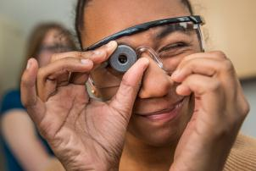
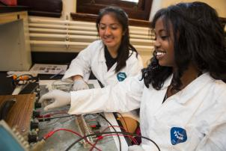
Memorandums of Understanding with School Districts: Database Fields
Yale STEM Outreach Participation
  STEM outreach programs offered
  Yale scientists participation
  K-12 Student Attendance
1501 TARGET STUDENTS
Over 400 in college
Female: 56%
First in Family: 48%
Asian: 12%
Black: 26%
Hispanic: 27%
Other: <1%
White: 34%
Demographic/Contact
  Name, DOB, Gender, Race/Ethnicity, etc.
Academic Performance
  GPA, Courses, Grades, Standardized Assessments, etc.
College Enrollment
2- and 4-year college enrollment, graduation, major

Slide 5
2013-2014
US Grant 180
Girls’ Science Investigations 5
Brain Education Day 5.5
CRISP Nanoday 2
Pathways to Engineering 3.5
Science on Saturday 2
Pathways Planetarium Visit… 2
2014-2015
US Grant 180
Science on Saturday 2
Girls Science Investigations 5
Science on Saturdays 2
CRISP Nanoday 2
Math Mornings… 2
2015-2016
US Grant 180
Pathways to Engineering 4
Pathways Chemistry Open House 4
Science on Saturdays 2
Math Mornings 2
Splash… 8
2016-2017
US Grant 180
Peabody Evolutions 60
Code New Haven 3
Pathways Genomics/Proteomics Day 4
Pathways Brain Education Day… 5.5
2017-2018
Pathways Summer Scholars 70
Peabody Evolutions 60
Green Café 1
ManyMentors Modeling Math 2
Science on Saturdays… 2
Grade | School | Gender | Race/ Ethnicity | Lunch Status | First in Fam to College | Hours in Yale STEM | GPA | Stand Test Math | Stand Test Sci | Latest Math Course Grade
11 | Wilbur Cross | F | Asian | Free | Not 1st | 1235 | 4.2 | 5 | 5 | A
11 | Career HS | F | Hispanic | Free | 1st | 210 | 4.3 | 5 | 5 | A+
11 | Career HS | F | White | Free | Not 1st | 305 | 4.3 | 5 | 5 | A-
11 | ESUMs | M | Hispanic | Pay | 1st | 29 | 4.3 | 5 | 4 | A+
11 | Wilbur Cross | F | Black | Pay | 1st | 1364 | 4.2 | 5 | 5 | A
11 | ESUMs | M | Black | Free | Not 1st | 225 | 4.2 | 5 | 5 | A
11 | Hillhouse HS | F | White | Pay | Not 1st | 20 | 4.1 | 5 | 5 | A-
11 | Career HS | M | Asian | Free | Not 1st | 831 | 4.1 | 5 | 4 | B
11 | Coop | M | Black | Pay | 1st | 14 | 4.1 | 5 | 5 | B
11 | ESUMs | M | Asian | Free | Not 1st | 3 | 4.1 | 5 | 5 | A-
11 | Career HS | F | Other | Free | 1st | 245 | 4.2 | 4 | 3 | B
11 | Hillhouse HS | M | White | Pay | 1st | 52 | 4.4 | 4 | 5 | A
11 | Hillhouse HS | F | Asian | Pay | Not 1st | 28 | 4.4 | 4 | 3 | A
11 | Career HS | F | White | Pay | Not 1st | 156 | 4.3 | 4 | 5 | A-
11 | Career HS | F | Asian | Free | Not 1st | 70 | 4.3 | 4 | 5 | B+
11 | Career HS | F | White | Pay | Not 1st | 58 | 4.3 | 4 | 5 | A
11 | Wilbur Cross | F | Other | Free | 1st | 106 | 4.2 | 4 | 5 | A
11 | ESUMs | F | Black | Free | Not 1st | 873 | 4.2 | 4 | 4 | B+
11 | Wilbur Cross | F | White | Free | Not 1st | 21 | 4.2 | 4 | 5 | A

Slide 6
SCAFFOLDED APPROACH
Y4. Undergraduate
Summer Lab Internships
Y3. High School Summer
Lab Internships
MORE SPECIALIZED
Y2. Summer Workshops
Y1. Public Lectures & Hands-on Demos
TIME

Slide 7
PROGRAM GROWTH
Yale Scientist Participation

Slide 8
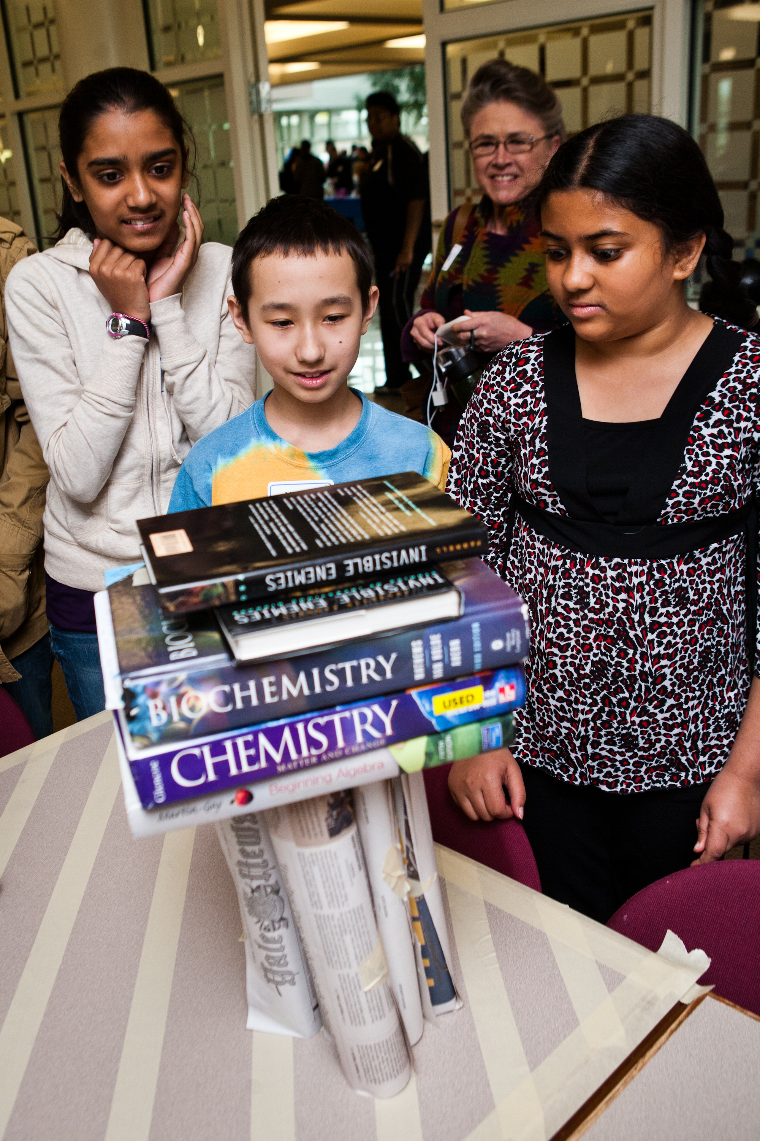
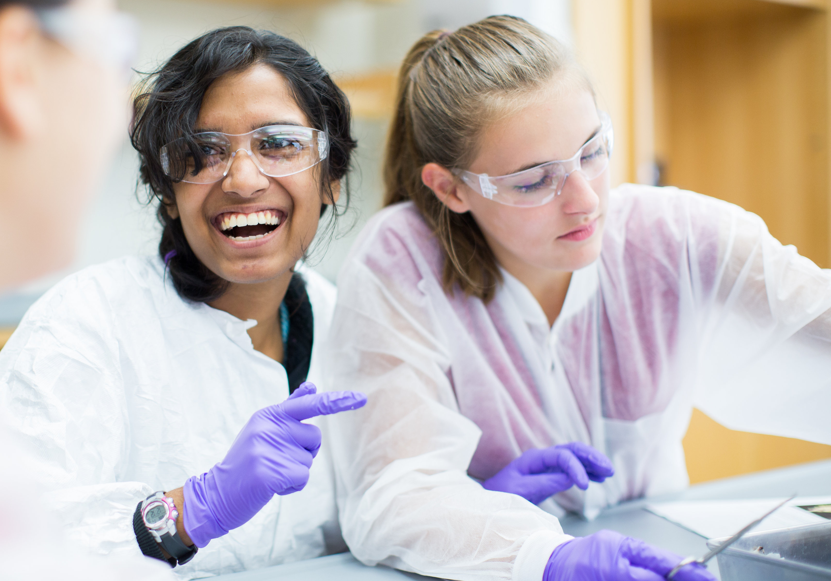
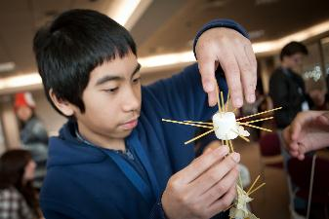
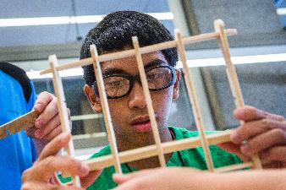
Benefits of coordinated STEM outreach
Better serve students by offering a pathway of continued and deepening program experiences
Lower barriers to participation for Yale faculty, staff, & students
Establishes a central point of contact for local students and school district staff
Better evaluate programming with a longitudinal database that tracks student participants through college completion
Sarah building a structure that can hold 10 lbs at the Pathways Festival in 2011
Sarah dissecting crayfish in her Neurobiology workshop Pathways Summer Scholars 2017
Joshua participating in the spaghetti-marshmallow challenge in 2011
Joshua building a chair in his Yale summer Engineering course in 2016

Slide 9
Thank You

Slide 10
STUDENT OUTCOMES
National Student Clearinghouse Data
College Graduates Who Reported STEM Majors
High School Classes of 2010 and 2011
PATHWAYS STUDENTS 57%
DISTRICT 39%
NATIONAL 8%

Slide 11
STUDENT OUTCOMES
National Student Clearinghouse Data
PATHWAYS STUDENTS 80%
Attended College
Classes of 2010-2015
DISTRICT 70%
NATIONAL 52%
PATHWAYS STUDENTS 60%
Completed College
Classes of 2010 and 2011
DISTRICT 23%
NATIONAL 19%
PATHWAYS STUDENTS 57%
Reported STEM Majors
Classes of 2010 and 2011
DISTRICT 39%
NATIONAL 8%

Slide 12
A Unified Approach to Science Outreach
Greater opportunities for students
Students reliably matched with appropriate sequences of activities
Long-term collaboration with school districts
Pathways initiative provides infrastructure
Rigorous longitudinal evaluation across programs
Unified approach to university outreach
High-impact sustainable outreach
Minimizes time required for effective faculty and student involvement
Robust content-neutral infrastructure available institution-wide
Faculty achieve Broader Impacts for grants
Faculty engage junior scholars in outreach
Faculty provide content expertise
Opportunities to teach and to communicate science

Slide 13
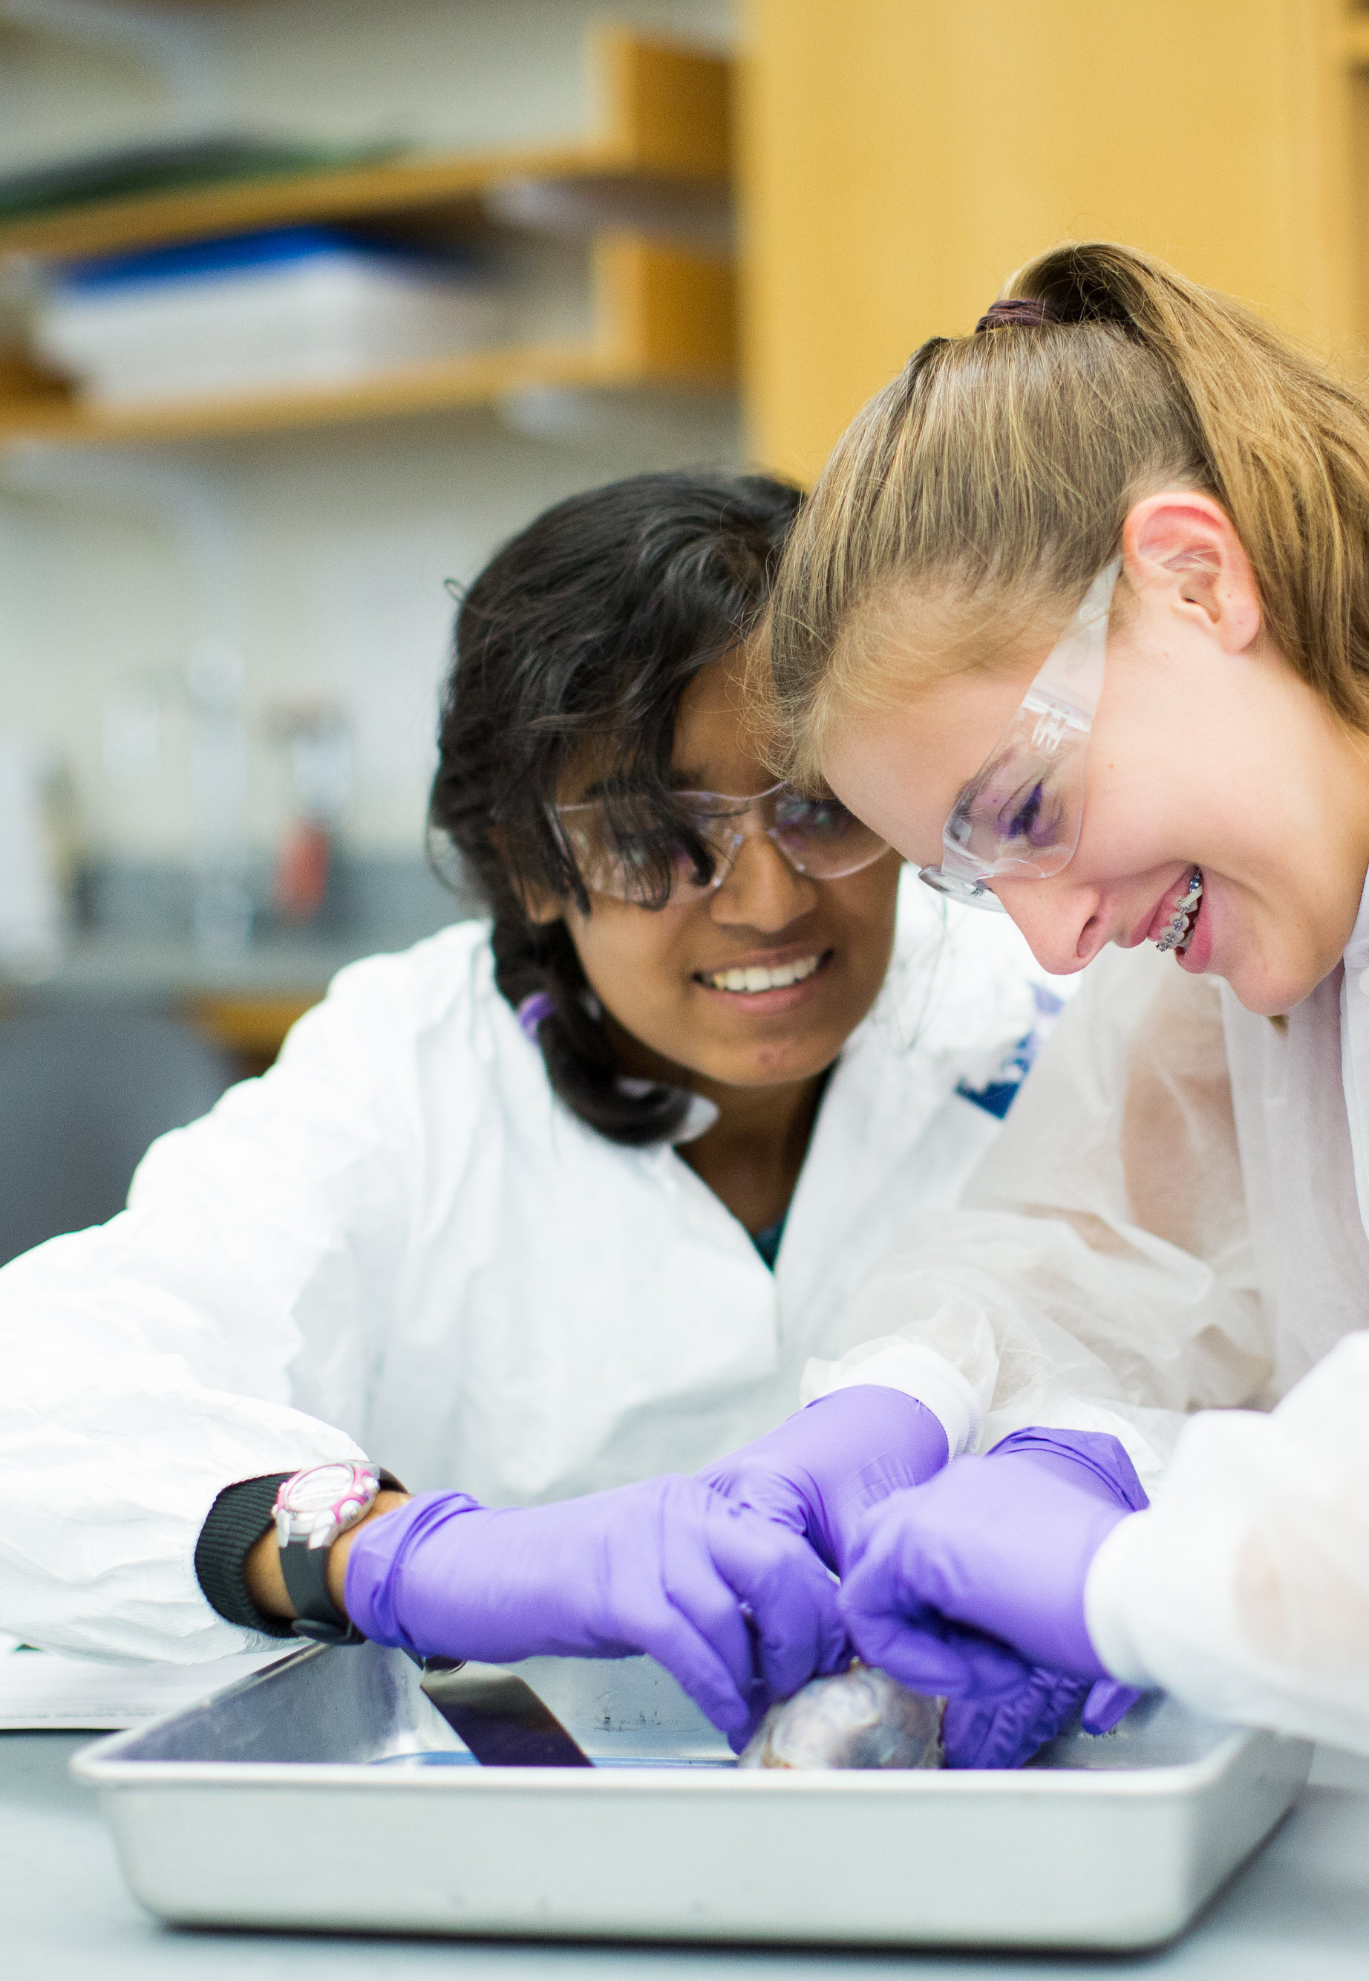
Pathways Summer Scholars Program
Yale Involvement – By the Numbers
29 Faculty Members
11 Research Scientists & Post-doctoral Associates
53 Graduate Students
6 Undergraduates
19 Staff Members
Sample Summer 2017 Workshops
Disorders of the Brain
The Chemistry of Beauty
It’s a Small, Wave-like World
Computer-Based Mapping in GIS
From the Bottom Up: Building Earth’s Ecosystems
Making Electricity from the Sun: Building a Solar Cell
Biotechnology: Engineering a Better Tomorrow
How Fast Do Bacteria Grow? Math, Modeling, & Microbes
Molecule by Molecule: Seeing & Manipulating Single Molecules
Musical Acoustics & Instrument Design: When Engineering Meets Music

Slide 14
Assisting Yale Scientists
Broader Impacts of NSF Grant Proposals
  Feasibility
  Diversity of target audience
  Scaffolded approach
  Data/tracking

